Slide 1


Interview Talk
姜笑雨
威斯康星大学麦迪逊分校物理系, Mark Saffman Group
2022/02/16

Slide 2

Overview
Introduction to neutral atom quantum computing and the Saffman group
My experiment projects
My theory projects

Slide 3
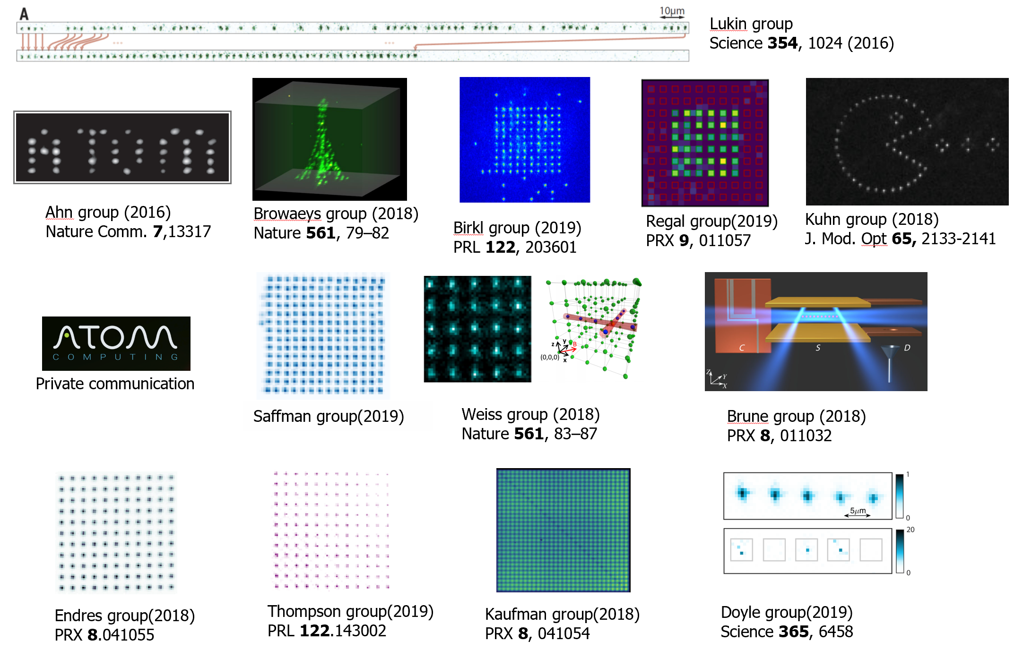
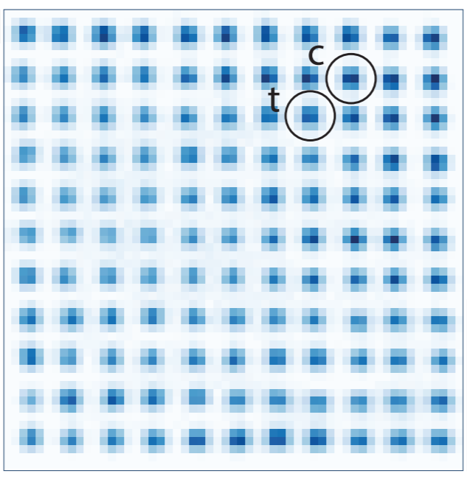
1. Introduction
Atomic Arrays for Quantum Computing/Simulations

Slide 4
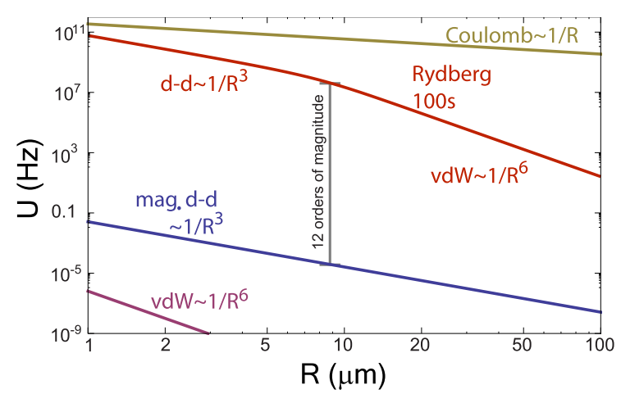
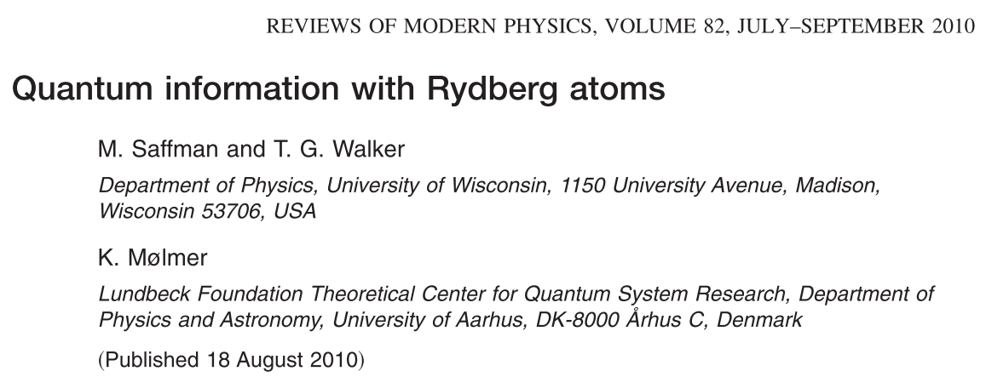
Rydberg Interactions
strong interaction
3 GHz @ 3 μm
Rydberg
lifetime
300 μs
Rydberg
Atoms
Cs 100s
12 orders of magnitude!
hyperfine
clock qubits
long coherence
~ 10 s
weak interaction
0.001 Hz @ 3 μm

Slide 5
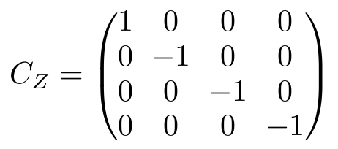
CZ gate with Rydberg blockade
66s_{1/2}
Cs
1038 nm
Ω
7p_{1/2}
ω_{q}
459 nm
6s_{1/2}
Ideal C_{Z} Gate
ω_{q}, B >> Ω >> 1/τ_{Ryd}
Jaksch, et al. PRL (2000)
Many other gate protocols are possible.

Slide 6
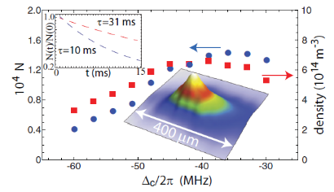
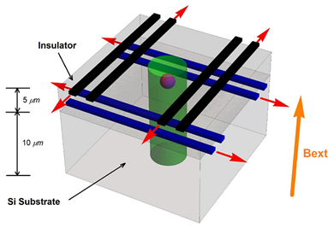
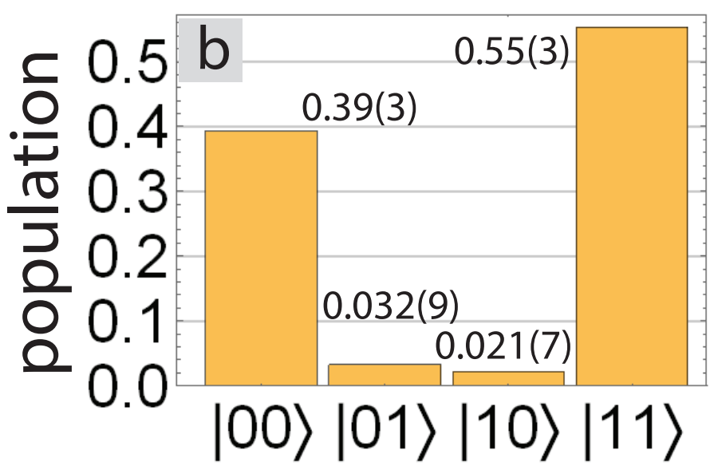
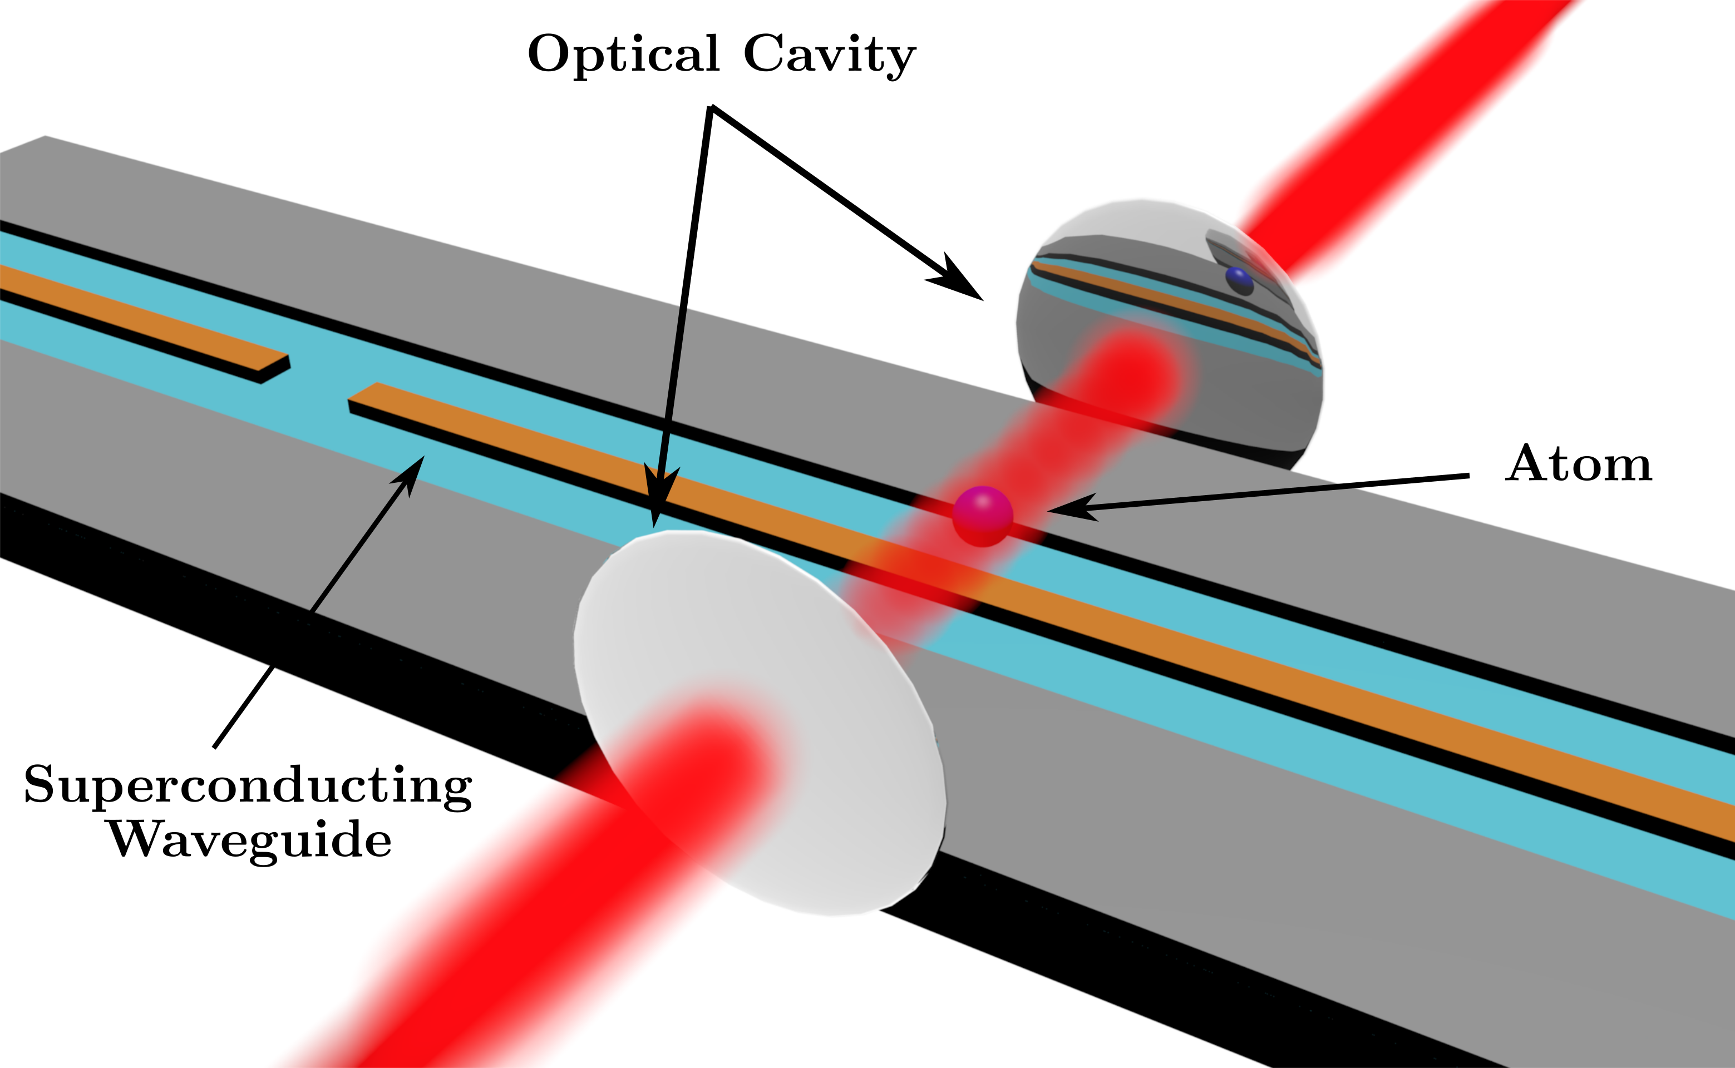
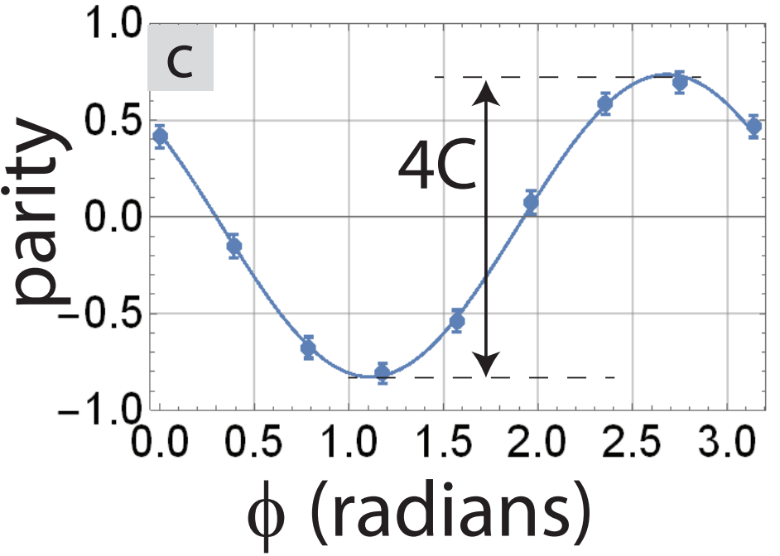
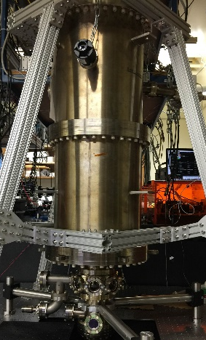
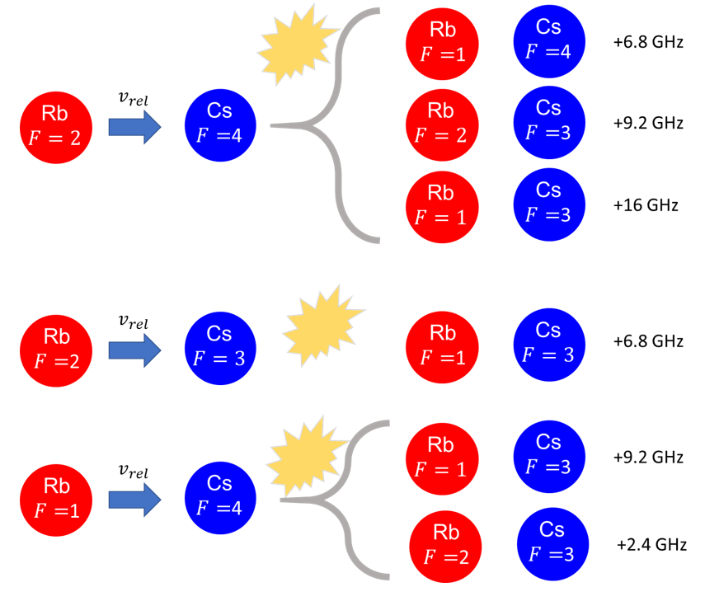
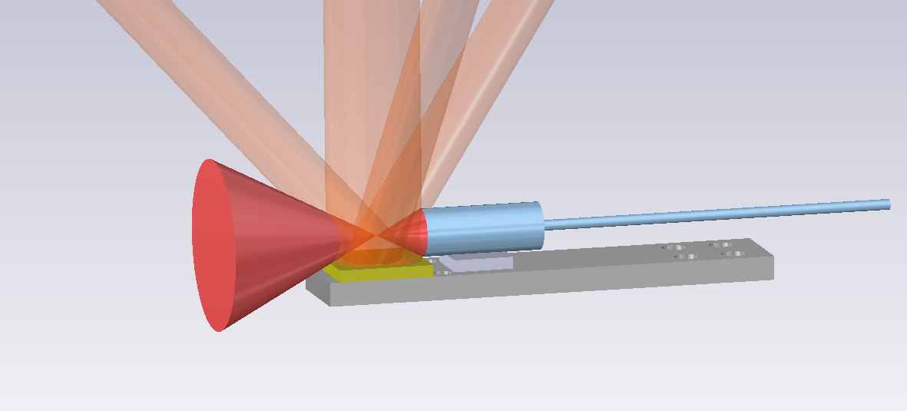
Experiments in Saffman lab
Rb : Ensemble qubits
Ho : Collective encoding
Rydberg
blockade
PRA 89, 041401 (2014), PRA 91, 012507 (2015)
Cs: Atomic qubit array
Cs : Atom-Superconductor interface
arXiv:2112.14589v3 [quant-ph] 11 Feb 2022
PRA 89, 010301 (2014)
PRA 96, 013833 (2017)
Rb+Cs : Functional quantum nodes
Integrated Photonics

Slide 7
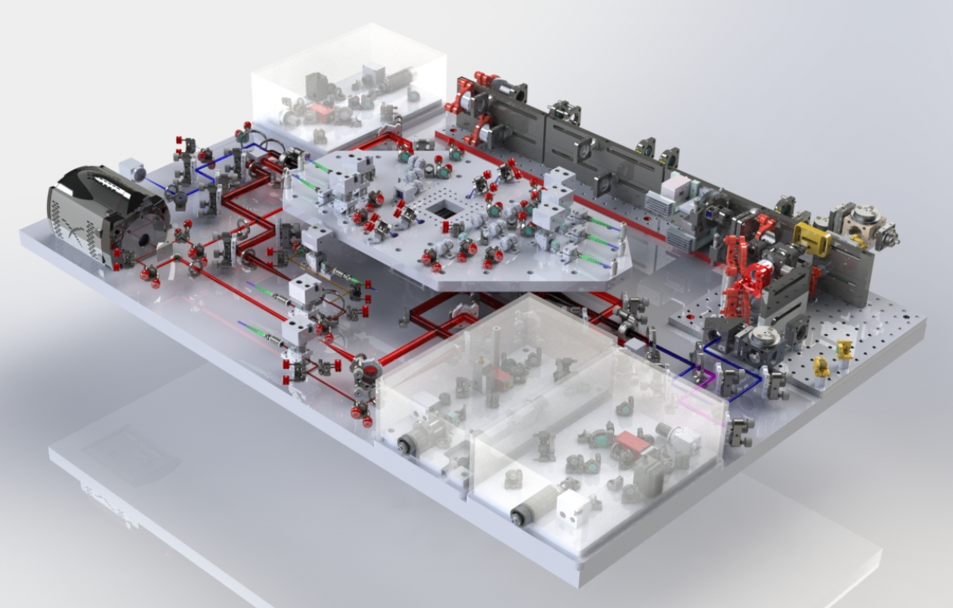
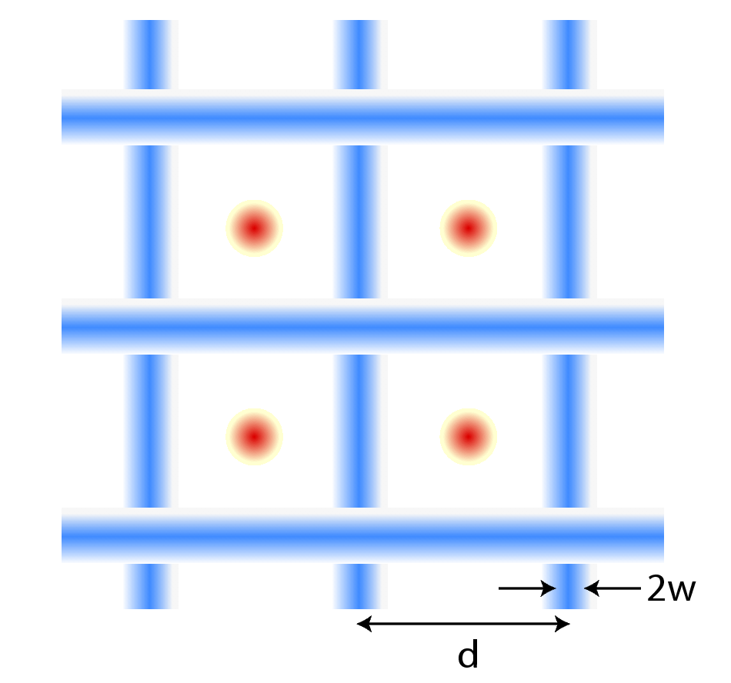
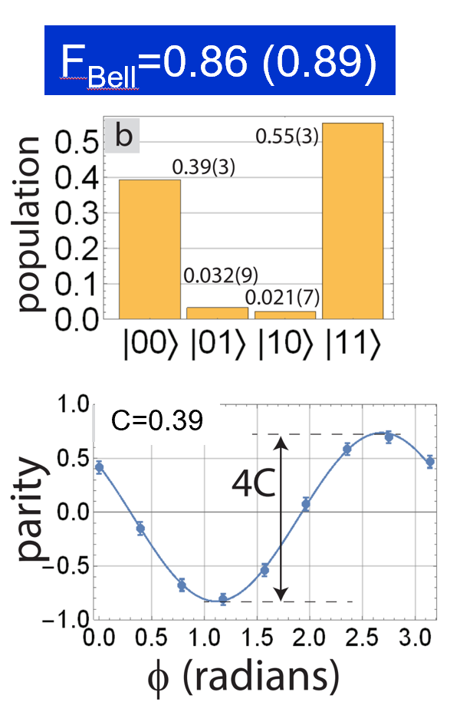
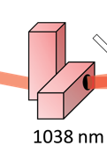
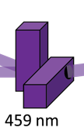
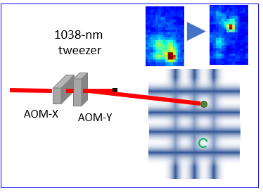

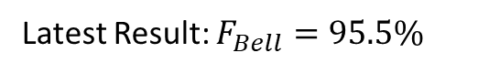
AQuA
f₁
f₂
f₁
459 nm
f₃
PRL 123 (23), 230501
Cooling & imaging
optics
f₄
PRL 123 (23), 230501
f₃
camera
dynamic
line array
Latest result F=0.95
Atom
rearranger
1038 nm
Latest Result: $F_{Bell}=95.5\%$
Rydberg
scanner

Slide 8
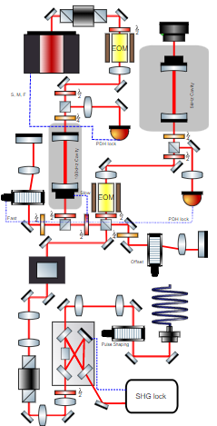
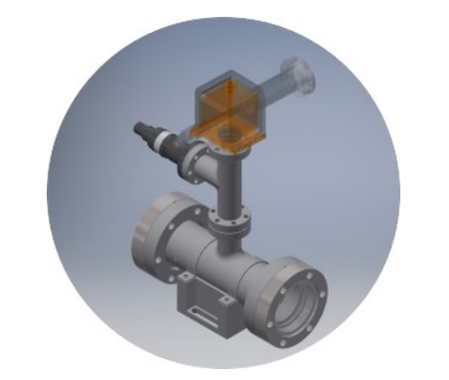
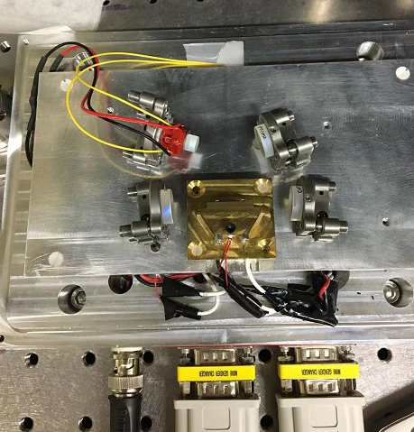
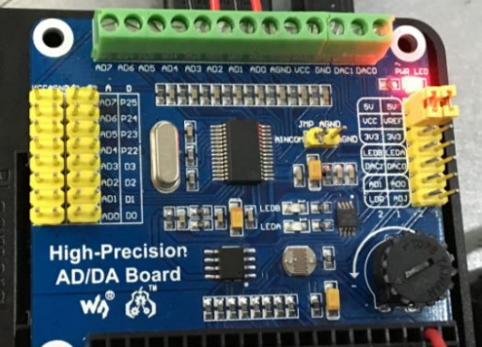
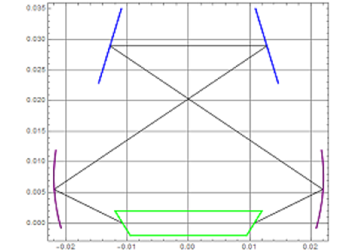
2. My experiment projects
A lot of optics: Keeping lasers/optics alive, laser/cavity frequency locking, frequency doubling, building reference cavities, etc.
Skills: Optics, Basic Electronics, Vacuum system, Solidworks, Front panel design, Machining, etc.

Slide 10
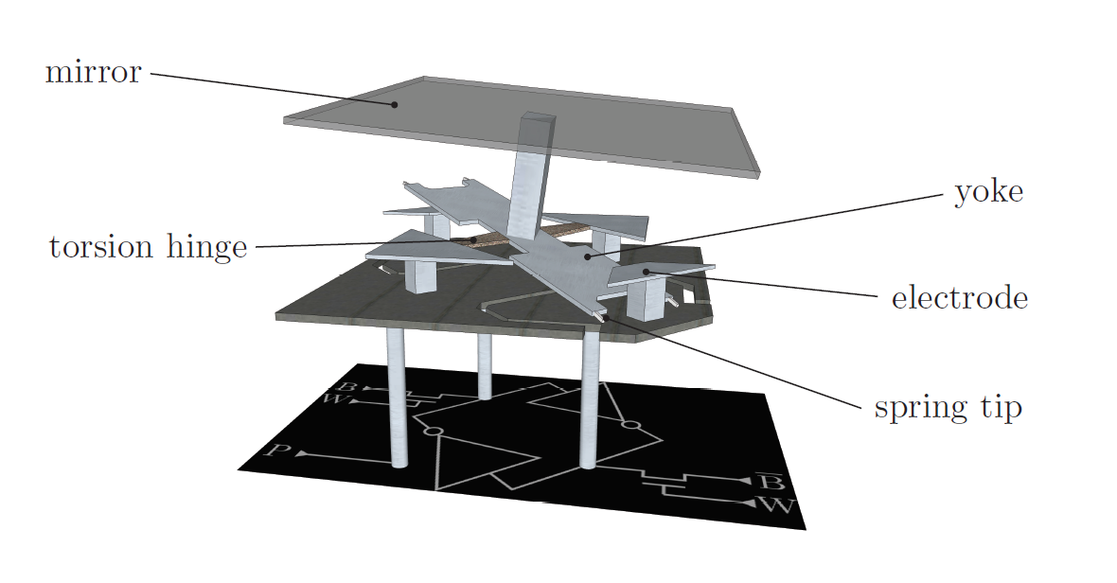
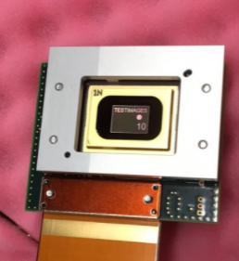
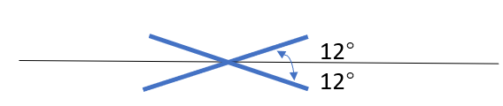
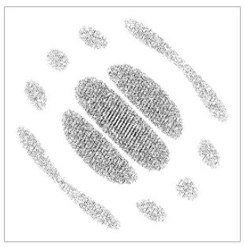
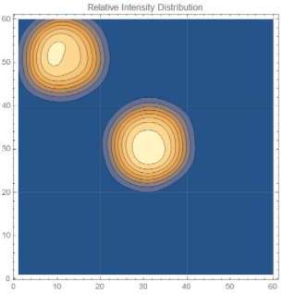
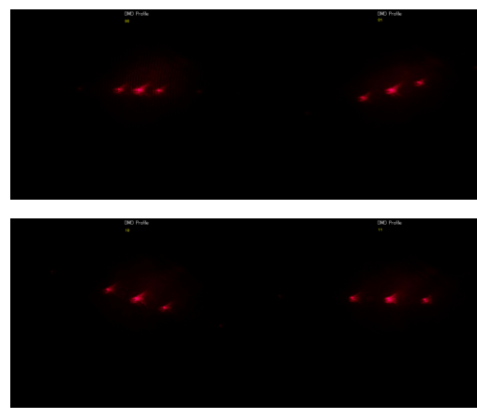
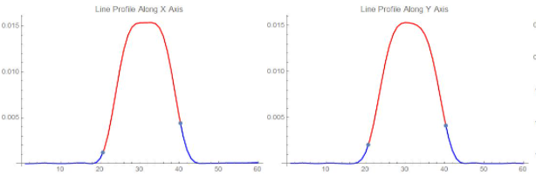
Experiment projects
Beam shaping with Digital Mirror Device(DMD)
1024×768 micromirrors
19kHz rate
Target: Address targets on the qubit array with top-hat beams and low crosstalk
Hologram
Image Plane
Beam Profile

Slide 11
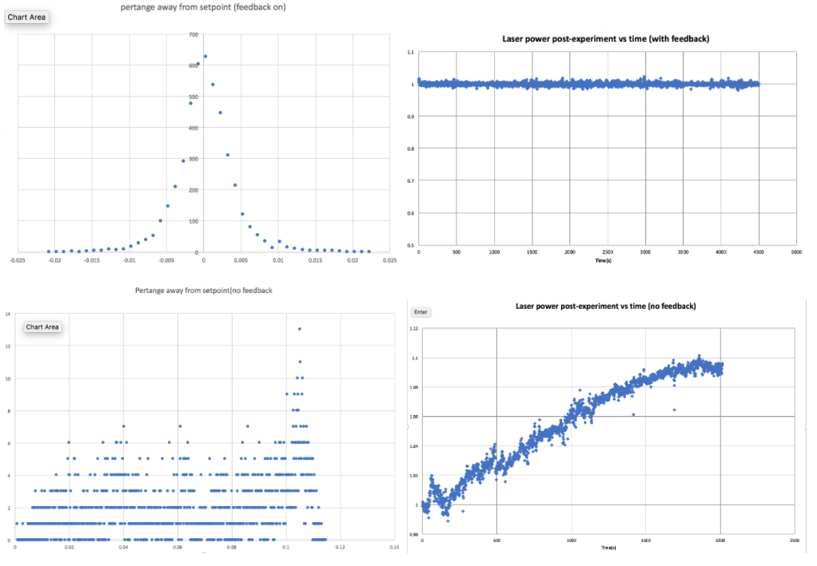
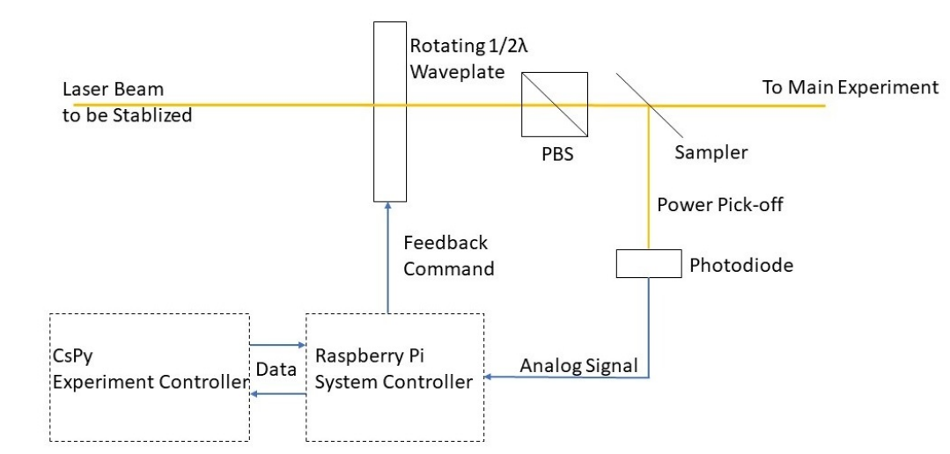
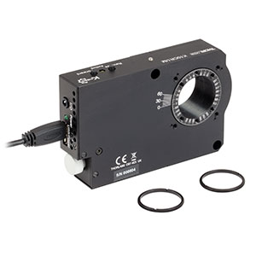
Experiment projects
Laser noise eater with rotating stage
Target: Reduce the DC drift of laser noise caused by room temperature, etc
Thorlabs K10CR1

Slide 12
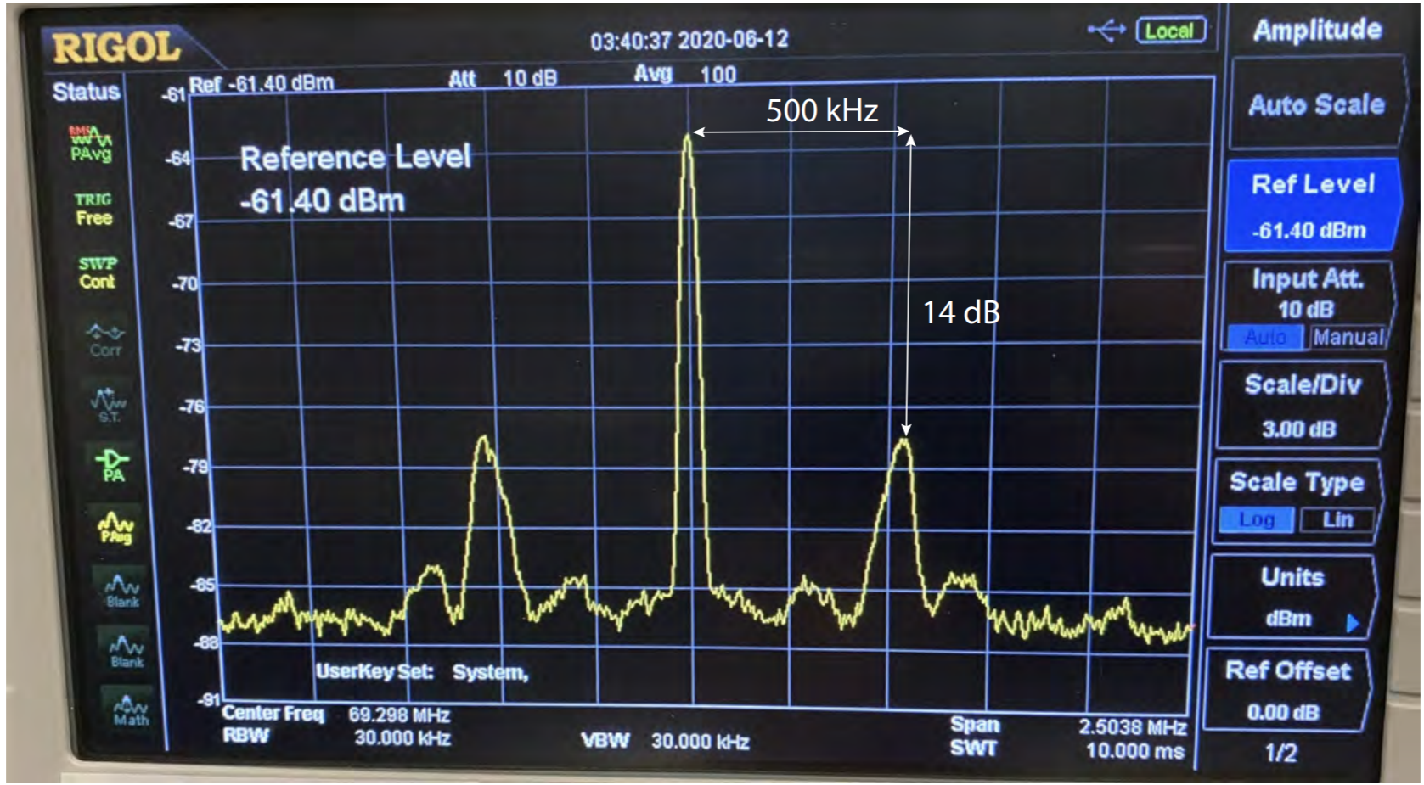
3. Theory projects: Laser noise analysis
The major error contributions comes from:
1) Finite temperature causing Doppler dephasing.
2) Finite temperature causing atom position
variation
3) Laser noise
Perfect laser: δ-function lineshape
Reality: Self-heterodyne measurements of a locked laser’s lineshape.
Finite Linewidth + Servo bumps

Slide 13
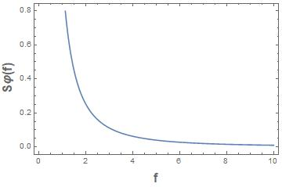
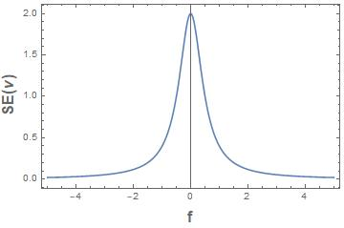
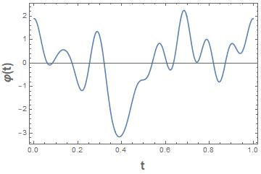
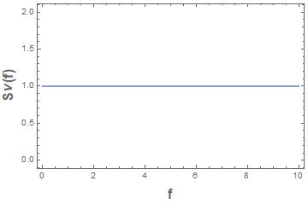
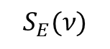
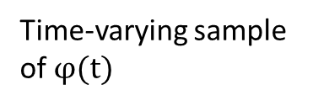
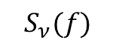
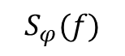
Example: frequency noise with Lorentzian lineshape
$$S_{φ}(f)$$
$$S_{E}(ν)$$
①
②
$$S_{ν}(f)$$
Carrier Spectrum
(Example: Lorentzian Lineshape)
Time-varying sample of $φ(t)$
Noise Spectrum for phase(above) and
frequency (below) noise

Slide 14
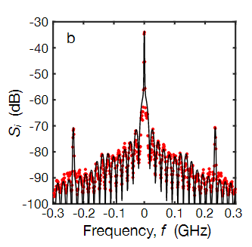
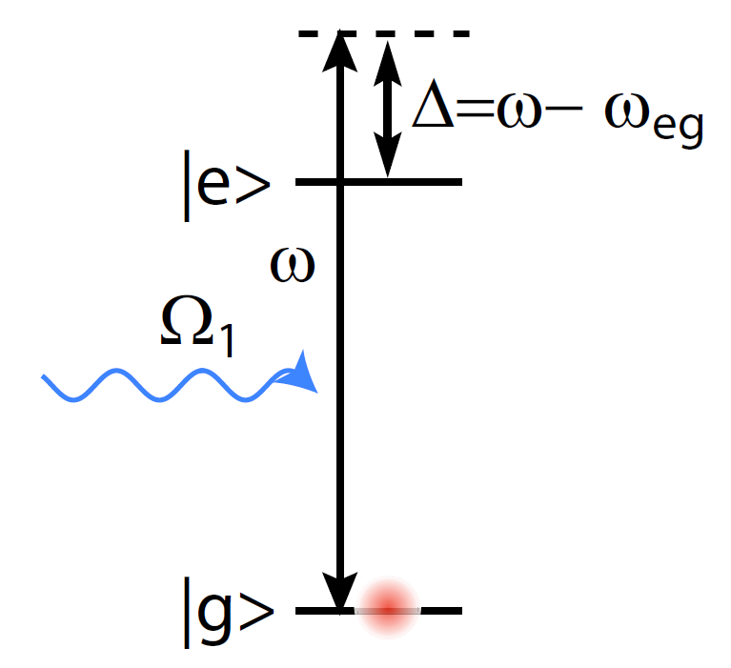
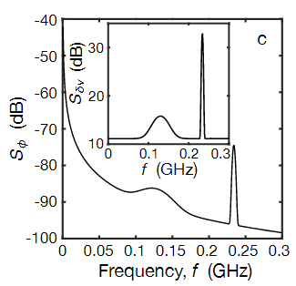
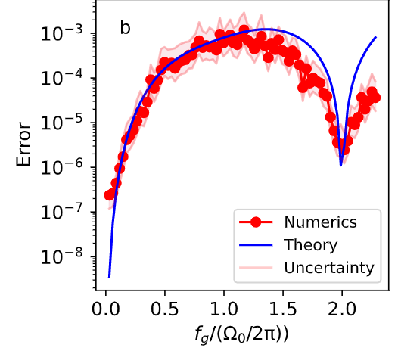
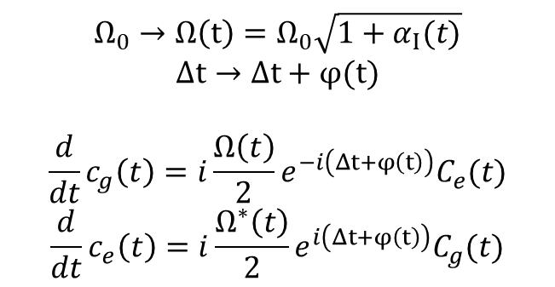
How to model laser noise
Lab self-heterodyne measurements
step1
Frequency noise spectrum
step2
Error calculated by simulation
Error predicted by theory
$$Ω_{0}→Ω\left(t\right)=Ω_{0}\sqrt{1+α_{Ι}(t)}$$
$$Δt→Δt+φ(t)$$
$$\frac{d}{dt}c_{g}\left(t\right)=i\frac{Ω\left(t\right)}{2}e^{−i\left(Δt+φ\left(t\right)\right)}C_{e}(t)$$
$$\frac{d}{dt}c_{e}\left(t\right)=i\frac{Ω^{∗}\left(t\right)}{2}e^{i\left(Δt+φ\left(t\right)\right)}C_{g}(t)$$
Quasi-static model
Time-series master equation

Slide 15
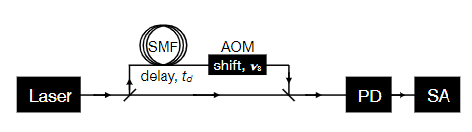








$S_{i}\left(f\right)→S_{E}\left(f\right)$ $→S_{ν}\left(f\right)$
White noise, with amplitude $h_{0}$
White noise+ servo bump, with amplitude $h_{0}$, servo bump amplitude $h_{g}$, center frequency $f_{g}$, width $σ_{g}$

Slide 16





$S_{i}\left(f\right)→S_{E}\left(f\right)$ $→S_{ν}\left(f\right)$
White noise, with amplitude $h_{0}$
White noise+ servo bump, with amplitude $h_{0}$, servo bump amplitude $h_{g}$, center frequency $f_{g}$, width $σ_{g}$

Slide 17





Error prediction: Quasi-static model
When the bandwidth of the laser noise is much less than the Rabi Frequency Ω, we can treat the noise simply as a random variable(not time-varying) drawn from a Gaussian distribution with variance σ.
One photon transition with frequency noise:
Two-photon transition with frequency noise, assuming the two photons have the same noise spectrum:

Slide 18



Error prediction: Time series master equation
We consider a two-level system of frequency $ν_{e}$driven resonantly by a monochromatic laser, with Rabi angular frequency $Ω_{R}$:
Consider extracting $φ(t)$ from the noise spectrum $S_{ν}(f)$:
Finally we get:
Where $N=Ω_{R}/(2π)$.
For two photon transitions, the errors generated by each laser is additive

Slide 19


Error calculation: Simulation with python
For each case generate a time series $φ(t)$ with random $ψ_{j}$s.
Do multiple times and take average

Slide 20


Comparison: Numerics and Theory
Servo bump spectrum, 1 photon
2 photon
1π
2π

Slide 21


Comparison: Numerics and Theory
Quasi-static theory, 1 photon
2 photon
Bandwidth=0.01 Ω
1π
2π
Linewidth (kHz)
Linewidth (kHz)

Slide 22


Comparison: Numerics and Theory
Quasi-staic model, Bandwidth=1 Ω
Error vs Fractional power in the servo bump
Next step: experiment with microwaves

Slide 23





3. Theory projects: Surface code and multi-qubit gate with neutral atoms
Surface code
● Error-correcting code that uses many physical qubits into a smaller number of logical qubits.
Example:
single (qu)bit-flip error channel
Classical:
Three qubit bit flip code:
Encode
Error
Decode
Correction
Logical Qubits

Slide 24



Surface code
● Applies stabilizer measurements to detect syndromes:
white dots: data qubits
black dots: measurement qubits
In one stabilizer measurement, there are
four C-NOTs and one projective measurements on the measurement qubit(syndrome).
Every round of stabilizer measurement is completed over the whole array before the next round begins.

Slide 25

Surface code
● Quiescent state of the stabilizer:
The quiescent state is random selected after 1st round of stabilizer measurements, but is then maintained, unless there is error.

Slide 26






Surface code
● Logical qubits:
41 data qubits=41×2 degrees of freedom.
40 measurement qubits=40×2
restrictions.
2 additional degrees of freedom to define a logical qubit.
One can define:
as the operations on the logical qubit.

Slide 27

Surface code
● Each round of stabilizer measurements gives a map of syndromes.
● Keep repeating to get a time series of syndrome maps.
● Decode from the syndrome maps to see which qubit is affected by error
● Apply error correction
Example: Surface-13 code

Slide 28




Syndrome Measurement:
Red: Syndrome flips in Z measurement
Green: Syndrome flips in X measurement
Black: No Syndrome flip
Y error in 2
1
2
3
4
5
6
7
8
9

Slide 29
1
Surface code
9
10
Choosing a decoder…
Z error
4
5
6
What could have happened:
● in 2: more likely
● X error in 1 and 3
11
12
7,8
9
1,4
3
2
9
10
5
X error
Decoder:
● Small codes like surface 13: Look-up table
● Larger codes: Minimum weight perfect matching, etc(dependent on noise type)
11
8
12
7
6,9

Slide 30




Surface code with neutral atoms
Advantages:
· Scalable and Reconfigurable
· Two-Species configuration supresses crosstalk between data and ancilla qubits

Slide 31



Quantum Computation: single qubit and CNOT gates are universal.
Large number of qubits
High fidelity universal gate set
Decomposing a multi-qubit gate into the universal set is not always efficient.
Example:
6 CNOT gates are needed to construct a Toffoli gate
Example:
20 CNOT gates are needed to construct a $C_{3}Z$gate
Cost: error, time

Slide 32


Slide 33


Slide 34


Slide 35




Matt Otten
Coupling strength varies in range $(Min\left(B\right)=B_{0}−δB,B_{0}+δB)$

Slide 36



Thank you!
Mark Saffman
Mark Friesen
Matt Otten

